Slide 2
Peter’s Final Message

Slide 3
2Peter 3:11-18
Seeing then that all these things shall be dissolved, what manner of persons ought ye to be in all holy conversation and godliness,
Looking for and hasting unto the coming of the day of God, wherein the heavens being on fire shall be dissolved, and the elements shall melt with fervent heat?

Slide 4
2Peter 3:11-18
Nevertheless we, according to his promise, look for new heavens and a new earth, wherein dwelleth righteousness.
Wherefore, beloved, seeing that ye look for such things, be diligent that ye may be found of him in peace, without spot, and blameless.

Slide 5
2Peter 3:11-18
And account that the longsuffering of our Lord is salvation; even as our beloved brother Paul also according to the wisdom given unto him hath written unto you;
As also in all his epistles, speaking in them of these things; in which are some things hard to be understood, which they that are unlearned and unstable wrest, as they do also the other scriptures, unto their own destruction.

Slide 6
2Peter 3:11-18
Ye therefore, beloved, seeing ye know these things before, beware lest ye also, being led away with the error of the wicked, fall from your own stedfastness.
But grow in grace, and in the knowledge of our Lord and Saviour Jesus Christ. To him be glory both now and for ever. Amen.

Slide 7
1Peter – Quick Overview
Theme: suffering, trials, and temptations are essential to our salvation

Slide 8
1Peter – Quick Overview
Theme: suffering, trials, and temptations are essential to our salvation
That the trial of your faith, being much more precious than of gold that perisheth, though it be tried with fire, might be found unto praise and honor and glory at the appearing of Jesus Christ: 1Peter 3:7

Slide 9
1Peter – Quick Overview
Chapter 2: Follow Him

Slide 10
1Peter – Quick Overview
Chapter 2: Follow Him
Chapter 3: Resist Adversary’s attacks

Slide 11
1Peter – Quick Overview
Chapter 2: Follow Him
Chapter 3: Resist Adversary’s attacks
Finally, be ye all of one mind, having compassion one of another, love as brethren, be pitiful, be courteous.
1Peter 3:8

Slide 12
1Peter – Quick Overview
Chapter 2: Follow Him
Chapter 3: Resist Adversary’s attacks
Chapter 4: Follow Him

Slide 13
1Peter – Quick Overview
Chapter 2: Follow Him
Chapter 3: Resist Adversary’s attacks
Chapter 4: Follow Him
Chapter 5: Resist Adversary’s attacks

Slide 14
2Peter – Quick Overview

Slide 15
2Peter – Quick Overview
Theme: growth in grace and knowledge are essential to salvation

Slide 16
2Peter – Quick Overview
Chapter 1: Grow in Christlikeness

Slide 17
2Peter – Quick Overview
Chapter 1: Grow in Christlikeness
And beside this, giving all diligence, add to your faith virtue; and to virtue knowledge;
And to knowledge temperance; and to temperance patience; and to patience godliness;

Slide 18
2Peter – Quick Overview
Chapter 1: Grow in Christlikeness
And to godliness brotherly kindness; and to brotherly kindness charity.
For if these things be in you, and abound, they make you that ye shall neither be barren nor unfruitful in the knowledge of our Lord Jesus Christ.

Slide 19
2Peter – Quick Overview
Chapter 1: Grow in Christlikeness
Wherefore the rather, brethren, give diligence to make your calling and election sure: for if ye do these things, ye shall never fall:
For so an entrance shall be ministered unto you abundantly into the everlasting kingdom of our Lord and Saviour Jesus Christ. 2Peter 1:5-8, 10, 11

Slide 20
2Peter – Quick Overview
Chapter 1: Grow in Christlikeness and Avoid False Teachings

Slide 21
2Peter – Quick Overview
Chapter 1: Grow in Christlikeness and Avoid False Teachings
Wherefore I will not be negligent to put you always in remembrance of these things, though ye know them, and be established in the present truth.
Yea, I think it meet, as long as I am in this tabernacle, to stir you up by putting you in remembrance;

Slide 22
2Peter – Quick Overview
Chapter 1: Grow in Christlikeness and Avoid False Teachings
Knowing that shortly I must put off this my tabernacle, even as our Lord Jesus Christ hath shewed me.
Moreover I will endeavour that ye may be able after my decease to have these things always in remembrance.

Slide 23
2Peter – Quick Overview
Chapter 1: Grow in Christlikeness and Avoid False Teachings
For we have not followed cunningly devised fables, when we made known unto you the power and coming of our Lord Jesus Christ, but were eyewitnesses of his majesty.
2Peter 1:12-16

Slide 24
2Peter – Quick Overview
Chapter 1: Grow in Christlikeness and Avoid False Teachings
Chapter 2: Avoid False Teachings

Slide 25
2Peter – Quick Overview
Chapter 1: Grow in Christlikeness and Avoid False Teachings
Chapter 2: Avoid False Teachings
Chapter 3: Remember the Truth

Slide 26
2Peter – Quick Overview
Chapter 1: Grow in Christlikeness and Avoid False Teachings
Chapter 2: Avoid False Teachings
Chapter 3: Remember the Truth
This second epistle, beloved, I now write unto you; in both which I stir up your pure minds by way of remembrance:

Slide 27
2Peter – Quick Overview
Chapter 1: Grow in Christlikeness and Avoid False Teachings
Chapter 2: Avoid False Teachings
Chapter 3: Remember the Truth
That ye may be mindful of the words which were spoken before by the holy prophets, and of the commandment of us the apostles of the Lord and Saviour:

Slide 28
2Peter – Quick Overview
Chapter 1: Grow in Christlikeness and Avoid False Teachings
Chapter 2: Avoid False Teachings
Chapter 3: Remember the Truth
Knowing this first, that there shall come in the last days scoffers, walking after their own lusts,

Slide 29
2Peter – Quick Overview
Chapter 1: Grow in Christlikeness and Avoid False Teachings
Chapter 2: Avoid False Teachings
Chapter 3: Remember the Truth
And saying, Where is the promise of his coming? for since the fathers fell asleep, all things continue as they were from the beginning of the creation. 2Peter 3:1-4

Slide 30
Peter’s Final Message

Slide 31
2Peter 3:11-18
Two Main Points:
How we should act Outwardly and
How we should react Inwardly . . .
. . . to events causing distress in the world

Slide 32
2Peter 3:11
Seeing then that all these things shall be dissolved, what manner of persons ought ye to be in all holy conversation and godliness.

Slide 33
2Peter 3:11
Seeing then that all these things are being dissolved, what manner of persons ought ye to be in all holy conversation and godliness.

Slide 34
2Peter 3:11
Seeing then that all these things are being dissolved, what manner of persons ought ye to be in all holy conversation and godliness.
We ought to be . . .

Slide 35
2Peter 3:11
Seeing then that all these things are being dissolved, what manner of persons ought ye to be in all holy conversation and godliness.
We ought to be . . . Peripoiesis !

Slide 36
1Peter 2:9
But ye are a chosen generation, a royal priesthood, an holy nation, a peculiar people; that ye should shew forth the praises of him who hath called you out of darkness into his marvellous light:

Slide 37
1Peter 2:9
But ye are a chosen generation, a royal priesthood, an holy nation, a peripoiesis people; that ye should shew forth the praises of him who hath called you out of darkness into his marvellous light:

Slide 38
1Peter 2:9
But ye are a chosen generation, a royal priesthood, an holy nation, a peripoiesis people; that ye should shew forth the praises of him who hath called you out of darkness into his marvellous light:
Peculiar: (1) unusual, odd, strange

Slide 39
1Peter 2:9
But ye are a chosen generation, a royal priesthood, an holy nation, a peripoiesis people; that ye should shew forth the praises of him who hath called you out of darkness into his marvellous light:
Peculiar: (1) unusual, odd, strange
(2) owned or possessed

Slide 40
May 20 Manna
A "peculiar people,"--not peculiar in dress, nor in manners, nor in language, nor in foolish, senseless forms and idiosyncrasies; but peculiar in that it is separate from the world and the spirit of the world. It has the Spirit of Christ--a spirit of full consecration to the Lord, and separateness from the world and its selfish aims. It is peculiar in its adherence to the Word of the Lord as its only law. . .

Slide 41
May 20 Manna
. . . It is peculiar in that it rejects worldly wisdom when it conflicts with the divine revelation. It is peculiar in that it is in the world, but not of the world. It is peculiar in that it has a decided faith and acts in harmony with its faith, and with zeal. It is peculiar in that it is self-sacrificing and knows no will but the will of its King. It is peculiar in that it knows the Truth and is able to give a reason for the hope within while others merely speculate and wonder and doubt.

Slide 42
May 20 Manna
A "peculiar people,"--not peculiar in dress, nor in manners, nor in language, nor in foolish, senseless forms and idiosyncrasies; but peculiar in that it is separate from the world and the spirit of the world. It has the Spirit of Christ--a spirit of full consecration to the Lord, and separateness from the world and its selfish aims. It is peculiar in its adherence to the Word of the Lord as its only law. . .

Slide 43
May 20 Manna
A "peculiar people,"--not peculiar in dress, nor in manners, nor in language, nor in foolish, senseless forms and idiosyncrasies; but peculiar in that it is separate from the world and the spirit of the world. It has the Spirit of Christ--a spirit of full consecration to the Lord, and separateness from the world and its selfish aims. It is peculiar in its adherence to the Word of the Lord as its only law. . .

Slide 44
May 20 Manna
A "peculiar people,"--not peculiar in dress, nor in manners, nor in language, nor in foolish, senseless forms and idiosyncrasies; but peculiar in that it is separate from the world and the spirit of the world. It has the Spirit of Christ--a spirit of full consecration to the Lord, and separateness from the world and its selfish aims. It is peculiar in its adherence to the Word of the Lord as its only law. . .

Slide 45
May 20 Manna
. . . It is peculiar in that it rejects worldly wisdom when it conflicts with the divine revelation. It is peculiar in that it is in the world, but not of the world. It is peculiar in that it has a decided faith and acts in harmony with its faith, and with zeal. It is peculiar in that it is self-sacrificing and knows no will but the will of its King. It is peculiar in that it knows the Truth and is able to give a reason for the hope within while others merely speculate and wonder and doubt.

Slide 46
Worldly Wisdom vs. Divine Wisdom
Worldly Wisdom:
If nobody catches you, then you did no wrong
Divine Wisdom:
There is nothing covered that shall not be revealed, neither hid that shall not be known Luke 12:2

Slide 47
Worldly Wisdom vs. Divine Wisdom
Worldly Wisdom:
Do unto others before they do unto you
Divine Wisdom:
Do good unto all men as you have opportunity Galatians 6:10

Slide 48
Worldly Wisdom vs. Divine Wisdom
Worldly Wisdom:
It’s OK to lie, cheat, or steal a little.
Divine Wisdom:
He that is faithful in that which is least is faithful also in much Luke 16:10

Slide 49
May 20 Manna
. . . It is peculiar in that it rejects worldly wisdom when it conflicts with the divine revelation. It is peculiar in that it is in the world, but not of the world. It is peculiar in that it has a decided faith and acts in harmony with its faith, and with zeal. It is peculiar in that it is self-sacrificing and knows no will but the will of its King. It is peculiar in that it knows the Truth and is able to give a reason for the hope within while others merely speculate and wonder and doubt.

Slide 50
May 20 Manna
. . . It is peculiar in that it rejects worldly wisdom when it conflicts with the divine revelation. It is peculiar in that it is in the world, but not of the world. It is peculiar in that it has a decided faith and acts in harmony with its faith, and with zeal. It is peculiar in that it is self-sacrificing and knows no will but the will of its King. It is peculiar in that it knows the Truth and is able to give a reason for the hope within while others merely speculate and wonder and doubt.

Slide 51
1Thessalonians 4:3
For this is the will of God, even your sanctification.

Slide 52
May 20 Manna
. . . It is peculiar in that it rejects worldly wisdom when it conflicts with the divine revelation. It is peculiar in that it is in the world, but not of the world. It is peculiar in that it has a decided faith and acts in harmony with its faith, and with zeal. It is peculiar in that it is self-sacrificing and knows no will but the will of its King. It is peculiar in that it knows the Truth and is able to give a reason for the hope within while others merely speculate and wonder and doubt.

Slide 53
May 20 Manna
. . . It is peculiar in that it rejects worldly wisdom when it conflicts with the divine revelation. It is peculiar in that it is in the world, but not of the world. It is peculiar in that it has a decided faith and acts in harmony with its faith, and with zeal. It is peculiar in that it is self-sacrificing and knows no will but the will of its King. It is peculiar in that it knows the Truth and is able to give a reason for the hope within while others merely speculate and wonder and doubt.

Slide 54
Reprint 1720
The victory or conquering power that energizes our whole being to patient endurance of tribulation even unto the end is our faith. Faith is knowledge applied, assimilated, and appropriated - made a part of our habit of thought, a basis for our actions and a spur to all our energies. Such a faith is the overcoming power which all must have who would run . . .

Slide 55
Reprint 1720
. . . successfully the race for the prize of our high calling. To be a conquering power, faith must go deeper than the head, it must go into the heart. Then faith will impel us to action, to works, which clearly manifest our faith. A mere intellectual assent to the truth of God that does not lead to activity in His service is not faith and can never overcome the world.

Slide 56
1Peter 2:9
But ye are a chosen generation, a royal priesthood, an holy nation, a peculiar people; that ye should shew forth the praises of him who hath called you out of darkness into his marvellous light:
Peculiar: (1) unusual, odd, strange
(2) owned or possessed

Slide 57
1Peter 2:9
But ye are a chosen generation, a royal priesthood, an holy nation, a peripoiesis people; that ye should shew forth the praises of him who hath called you out of darkness into his marvellous light:
Peculiar: (1) unusual, odd, strange
(2) owned or possessed

Slide 58
1Peter 2:9
But ye are a chosen generation, a royal priesthood, an holy nation, a purchased possession; that ye should shew forth the praises of him who hath called you out of darkness into his marvellous light:

Slide 59
1Peter 2:9,10
But ye are a chosen generation, a royal priesthood, an holy nation, a purchased possession; that ye should shew forth the praises of him who hath called you out of darkness into his marvellous light:
Which in time past were not a people, but are now the people of God: which had not obtained mercy, but now have obtained mercy.

Slide 60
1Peter 2:9,10
But ye are a chosen generation, a royal priesthood, an holy nation, a peculiar people; that you may declare the perfections of Him who called you from darkness into his wonderful light: (Diaglott)
Which in time past were not a people, but are now the people of God: which had not obtained mercy, but now have obtained mercy.

Slide 61
2Peter 3:12-13
Looking for and hasting unto the coming of the day of God, wherein the heavens being on fire shall be dissolved, and the elements shall melt with fervent heat?
Nevertheless we, according to his promise, look for new heavens and a new earth, wherein dwelleth righteousness.

Slide 62
2Peter 3:14
Wherefore, beloved, seeing that ye look for such things, be diligent that ye may be found of him in peace, without spot, and blameless.

Slide 63
2Peter 3:14
Wherefore, beloved, seeing that ye look for such things, be diligent that ye may be found of him in peace, without spot, and blameless.

Slide 64
Peace – Isaiah 26:3
Thou wilt keep him in perfect peace, whose mind is stayed on thee: because he trusteth in thee.

Slide 65
Manna – July 17
This is not worldly peace, not the peace of indifference, not the peace of sloth, not the peace of self-indulgence, not the peace of fatalism; but it is the peace of Christ--"My peace." Looking back we can see that the Master preserved His peace with God under all conditions. It is a peace which implicitly trusts to the divine wisdom, love,

Slide 66
Manna – July 17
justice and power, a peace which remembers the gracious promise made to the Lord's faithful --that nothing shall by any means hurt His faithful, and that all things shall work together for good to them that love God. This peace can accept by faith whatever divine providence permits, and can look through its tears with joyful

Slide 67
Manna – July 17
expectancy for the ultimate blessings which the Master has promised, and of which the present peace and joy are merely foretastes.

Slide 68
2Peter 3:14
Wherefore, beloved, seeing that ye look for such things, be diligent that ye may be found of him in peace, without spot, and blameless.

Slide 69
2Peter 3:14
Wherefore, beloved, seeing that ye look for such things, be diligent that ye may be found of him in peace, without spot, and blameless.
Without spot: Righteous Conduct

Slide 70
2Peter 3:14
Wherefore, beloved, seeing that ye look for such things, be diligent that ye may be found of him in peace, without spot, and blameless.
Without spot: Righteous Conduct
Blameless: Above reproach

Slide 71
2Peter 3:15, 9
And account that the longsuffering of our Lord is salvation; even as our beloved brother Paul also according to the wisdom given unto him hath written unto you;

Slide 72
2Peter 3:15, 9
And account that the longsuffering of our Lord is salvation; even as our beloved brother Paul also according to the wisdom given unto him hath written unto you;
The Lord is not slack concerning his promise, as some men count slackness; but is longsuffering to us-ward, not willing that any should perish, but that all should come to repentance.

Slide 73
2Peter 3:15, 9
And account that the longsuffering of our Lord is salvation; even as our beloved brother Paul also according to the wisdom given unto him hath written unto you;
The Lord is not slack concerning his promise, as some men count slackness; but is longsuffering to us-ward, not willing that any should perish, but that all should come to repentance.

Slide 74
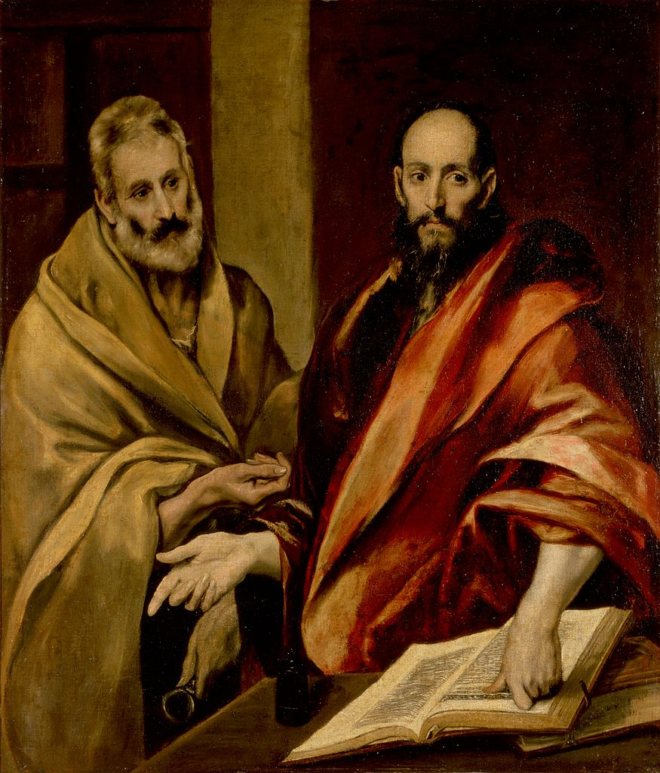

Slide 75
2Peter 3:16,17
As also in all his epistles, speaking in them of these things; in which are some things hard to be understood, which they that are unlearned and unstable wrest, as they do also the other scriptures, unto their own destruction.
Ye therefore, beloved, seeing ye know these things before, beware lest ye also, being led away with the error of the wicked, fall from your own stedfastness.

Slide 76
2Peter 3:18
But grow in grace, and in the knowledge of our Lord and Savior Jesus Christ.

Slide 77
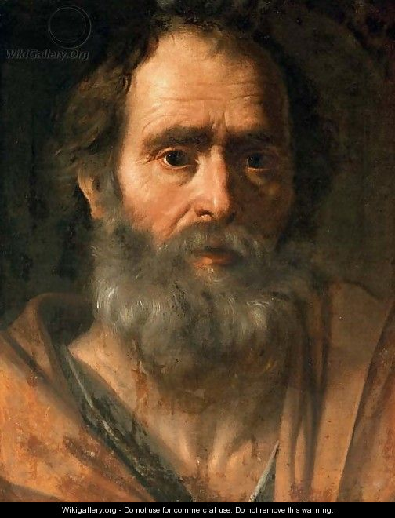

Slide 78
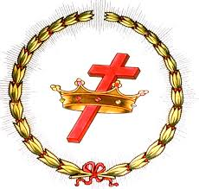
WIN YOUR CROWN!

